Slide 1
CG2271 Real Time Operating Systems
Lab Lecture 3
Interrupt Programming
(Reference Guide Section 3.2)

Slide 2
Introduction
Lab Lecture 3 – Interrupt Programming

Slide 3
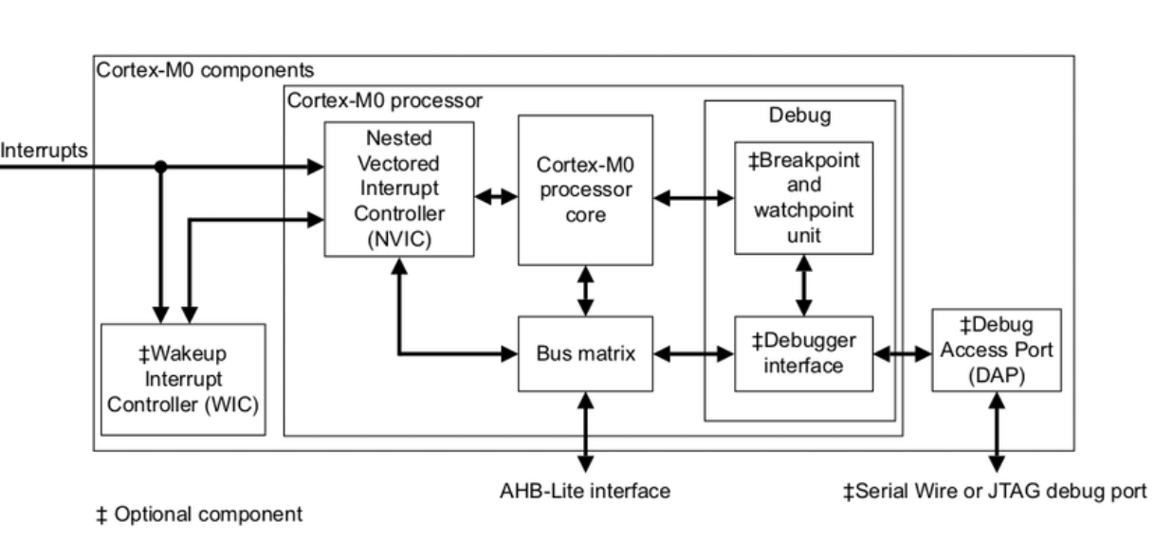
Introduction
The MCXC444 uses a priority interrupt system centred around a Nested Vector Interrupt Controller (NVIC).
  All interrupts generated by devices on the MCU pass through the NVIC:

Slide 4
Nested vectored interrupt controller
Lab Lecture 3 – Interrupt Programming

Slide 5
Nested Vectored Interrupt Controller
The NVIC is:
  Nested:
    Meaning that higher priority interrupts can interrupt ongoing lower priority interrupts.
    Alternatively, lower priority interrupts are delayed until higher priority interrupts are completed.
  Vectored:
    When an interrupt is triggered, execution is “vectored” to a particular interrupt service routine (ISR) to handle the interrupt.
    To facilitate this, every interrupt is assigned a number – “vector”.
    Interrupt numbers 0 to 15 are reserved for the MCU core.
      System errors, non-maskable interrupt, RESET, etc.
    Interrupts 16 and above are for various hardware units.

Slide 6
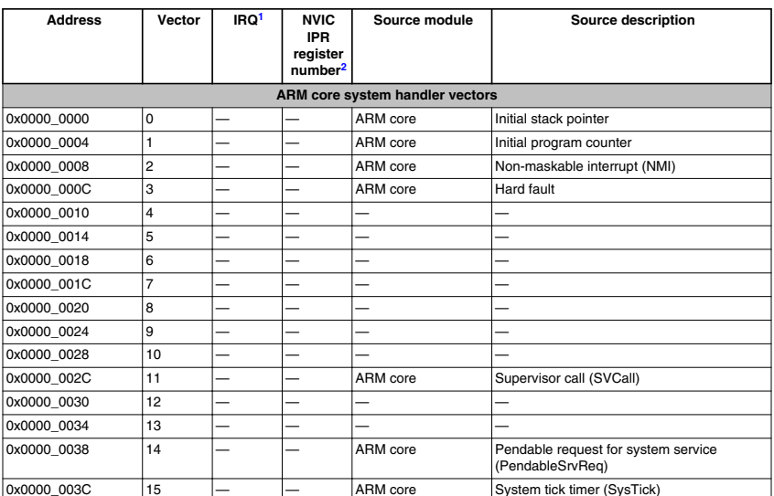
NVIC Vectors
Core Vectors (0 to 15)

Slide 7
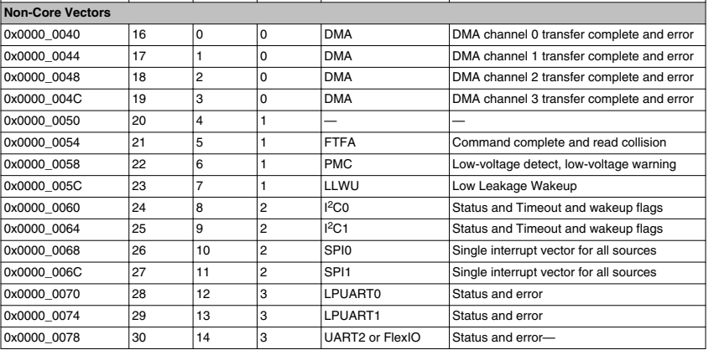

NVIC Vectors
Non-core Vectors ($≥16)$

Slide 8
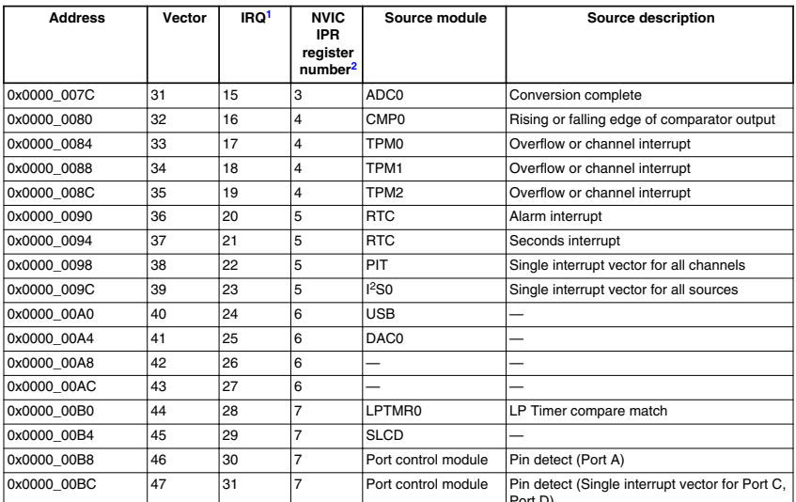
NVIC Vectors
Non-core Vectors ($≥16)$

Slide 9
External interrupts
Lab Lecture 3 – Interrupt Programming

Slide 10
External Interrupts
Like the ATMega328P on the Arduino, GPIO pins on the MCXC444 can be configured to generate interrupts
  Divided into two groups:
    Port A
    Ports C and D are combined into one group.

Slide 11
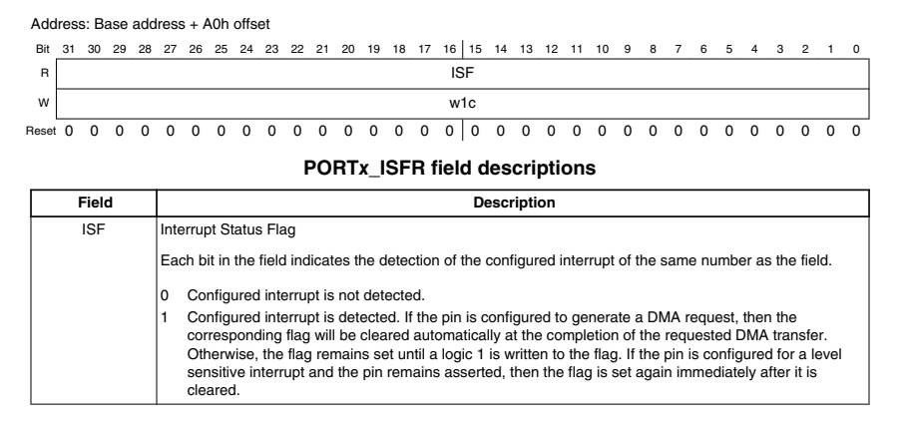
External Interrupts
Every port (A, C, and D) has an Interrupt Status Flag Register (ISFR), e.g. PORTA_ISFR.
  If an interrupt is trigged on a pin (e.g. PTA4), bit 4 in PORTA->ISFR would be set.

Slide 12
Configuring external interrupts
Lab Lecture 3 – Interrupt Programming

Slide 13
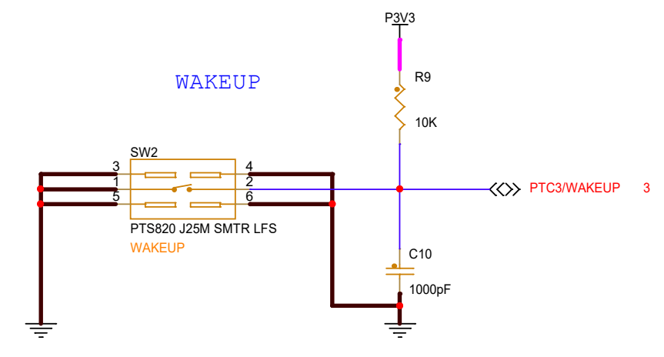
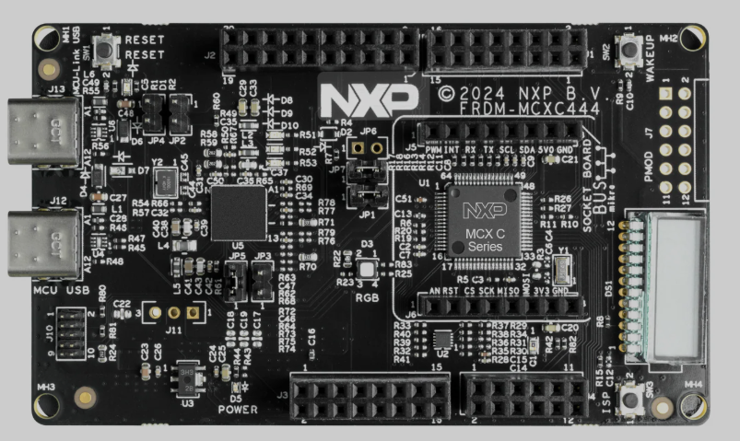
Configuring External Interrupts
We will now look at an example of how to configure an external interrupt.
  We choose SW2 on the FRDM-MCXC444 board, which is connected to PTC3.
  Gives us a chance to see how to use the combined PORTC_PORTD interrupt vector.

Slide 14

Initial Steps
Step 0: Define SWITCH_PIN:
Step 1: Disable the PORTC_PORTD interrupt.
Step 2: Turn on clocking to Port C using SIM_SCGC5:

Slide 15
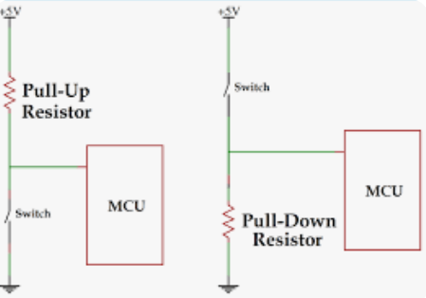
Pull-up/down Resistors
Step 3: Enable internal pull-up resistor.
  The MCXC444 has built-in pull-up or pull-down resistors.
    Pull-up resistors: weakly drives a line high until an event (e.g. closing a switch) drives it low.
    Pull-down resistor: Weakly drives a line low until an event drives it high.

Slide 16
Pull-up/down Resistors
  SW2 on the FRDM-MCXC444 is already pulled high:
  However just for learning purposes we will activate the internal pull-up resistor on the MCXC444.

Slide 17
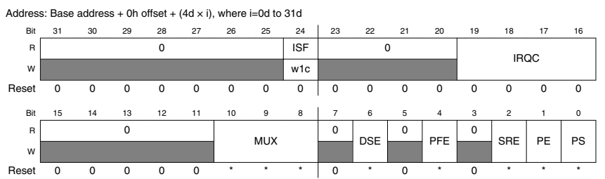
Pull-up/down Resistors
The pull-up/pull-down resistors are configured using the PE and PS bits in the PORTx_PCRy pin configuration register.

Slide 18
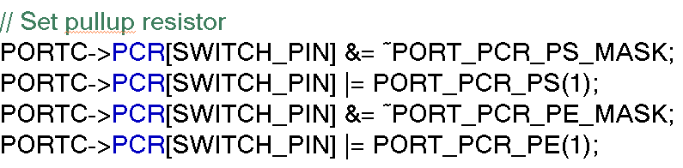
Pull-up/down Resistors
  PE (Pull enable):
    0 - Disable pull-up/down resistor, 1 – Enable
  PS (Pull select):
    0 – Enable pull-down resistor if PE = 1.
    1 – Enable pull-up resistor if PE = 1
We are going to enable the pull-up resistor and so PS = PE = 1.

Slide 19
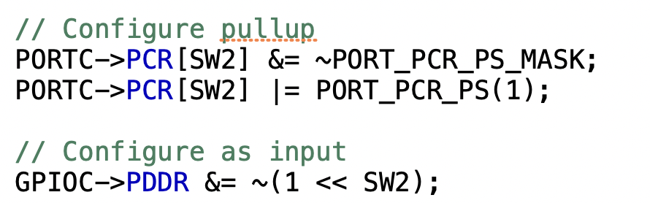
Configure Pin as GPIO and Input
Step 4: We configure PTC3 as GPIO and as an input pin (configuring as input is optional):

Slide 20
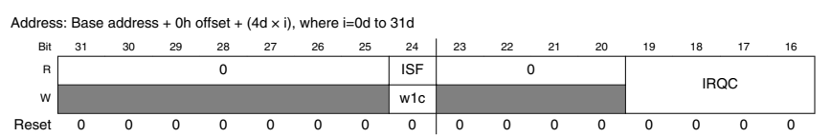
Configure Interrupt Triggering Type
Step 5: Configure Triggering Type.
  Like the ATMega328P, the MCXC444’s interrupts can be triggered in several ways:
  Controlled using the IRQC (Interrupt Configuration) bits of PORTx_PCRy:

Slide 21
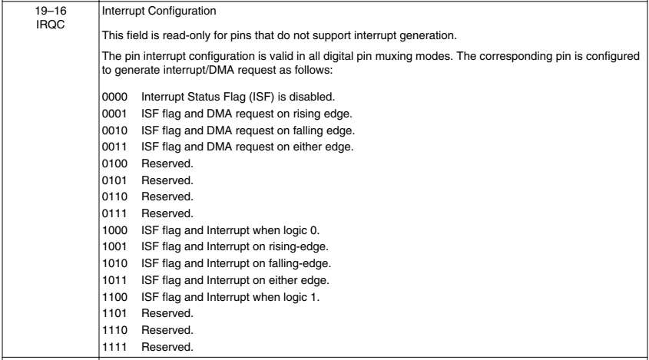
Configure Interrupt Triggering Type

Slide 22
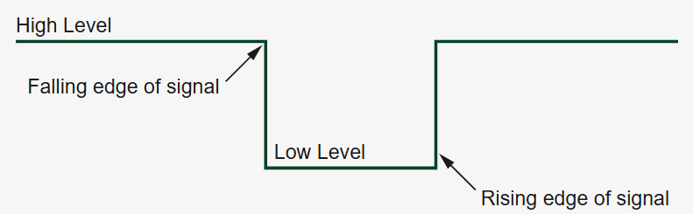
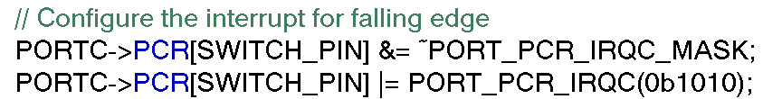
Configure Interrupt Triggering Type
Since our switch is active low (i.e. pulls PTC3 low when pressed), we will trigger on the falling edge (0b1010)

Slide 23
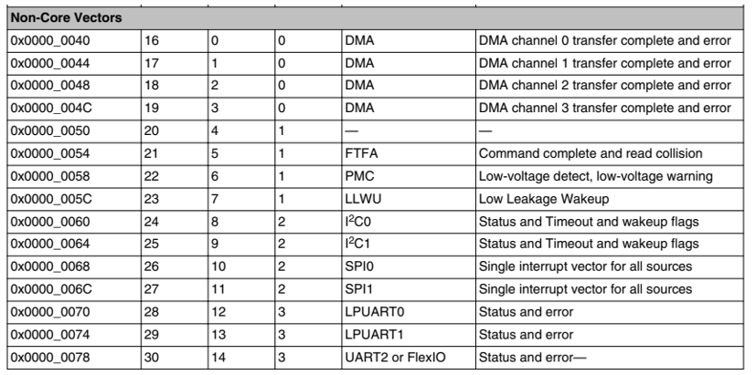
Setting IRQ Priority
Step 6: Set the Interrupt Priority Level.
  The NVIC stores priority levels for each interrupt in a set of 8 interrupt priority registers (IPRs) in this format.
IPR Number

Slide 24

Setting IRQ Priority
  Each IPR stores the priority number for four interrupts.
    Each priority is represented by a 2 bit number + 6 0’s.
  The priority levels are therefore:
    00|000000 = 0 (highest)
    01|000000 = 64
    10|000000 = 128
    11|000000 = 192 (lowest)

Slide 25
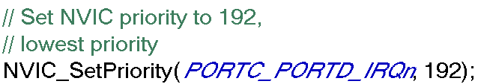
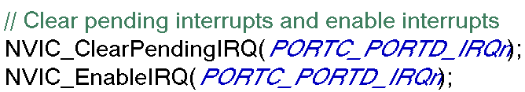
Setting IRQ Priority
We set our SW2 button as the lowest priority:
Step 7: Clear existing interrupts and re-enable.

Slide 26
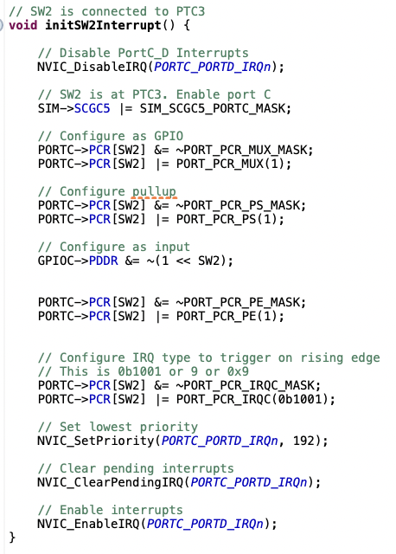
Full Setup Code

Slide 27
Writing the ISR
Lab Lecture 3 – Interrupt Programming

Slide 28
Writing the ISR
To write the ISR, we need to capture the PORTC_PORTD_IRQn interrupt vector.
  This vector invokes the PORTC_PORTD_IRQHandler function.
Steps in your ISR:
  Clear the pending IRQ.
  Use the ISFR register of the relevant port (in this case port C or port D) to see if the interrupt we are interested in is triggered.
  Write a “1” to the corresponding ISFR bit to reset it back to 0.
Code is shown on next page.

Slide 29
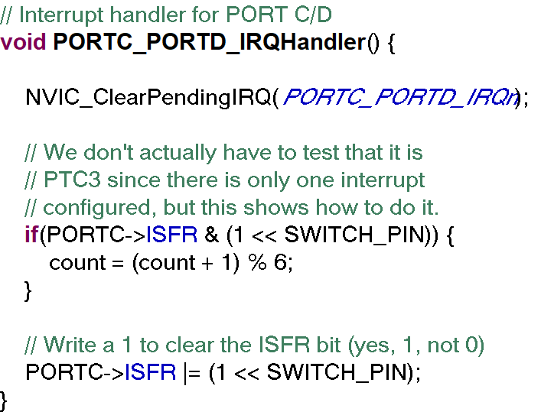
Writing the ISR

Slide 30
Useful Functions and Macros
Some useful functions and macros:
  Interrupt vectors for the ports:
    PORTA_IRQn, PORTC_PORTD_IRQn
  NVIC Functions:
    NVIC_DisableIRQ(vector): Disables interrupt vector
      NVIC_DisableIRQ(PORTA_IRQn);
    NVIC_EnableIRQ(vector): Enables interrupt vector
      NVIC_EnableIRQ(PORTA_IRQn);
    NVIC_SetPriority(vector, priority): Sets the priority level of the interrupt
      NVIC_SetPriority(PORTA_IRQn, 64);
    NVIC_ClearPendingIRQ(vector): Clears pending interrupt requests.
      NVIC_ClearPendingIRQ(PORTA_IRQn);

Slide 31
Useful Functions and Macros
IRQ Handler Names:
  void PORTA_IRQHandler() {
  }; // For Port A
  void PORTC_PORTD_IRQHandler() {
  }; // for Ports C and D

Slide 32
Conclusion
In this lecture we looked at how to configure external interrupts on Ports A, C and D.
In the next lecture we will see interrupts again as we learn how to program the Timer/PWM Modules (TPMs) on the MCXC444.

